Slide 2
Ecclesiastes 11:4-6

Slide 3
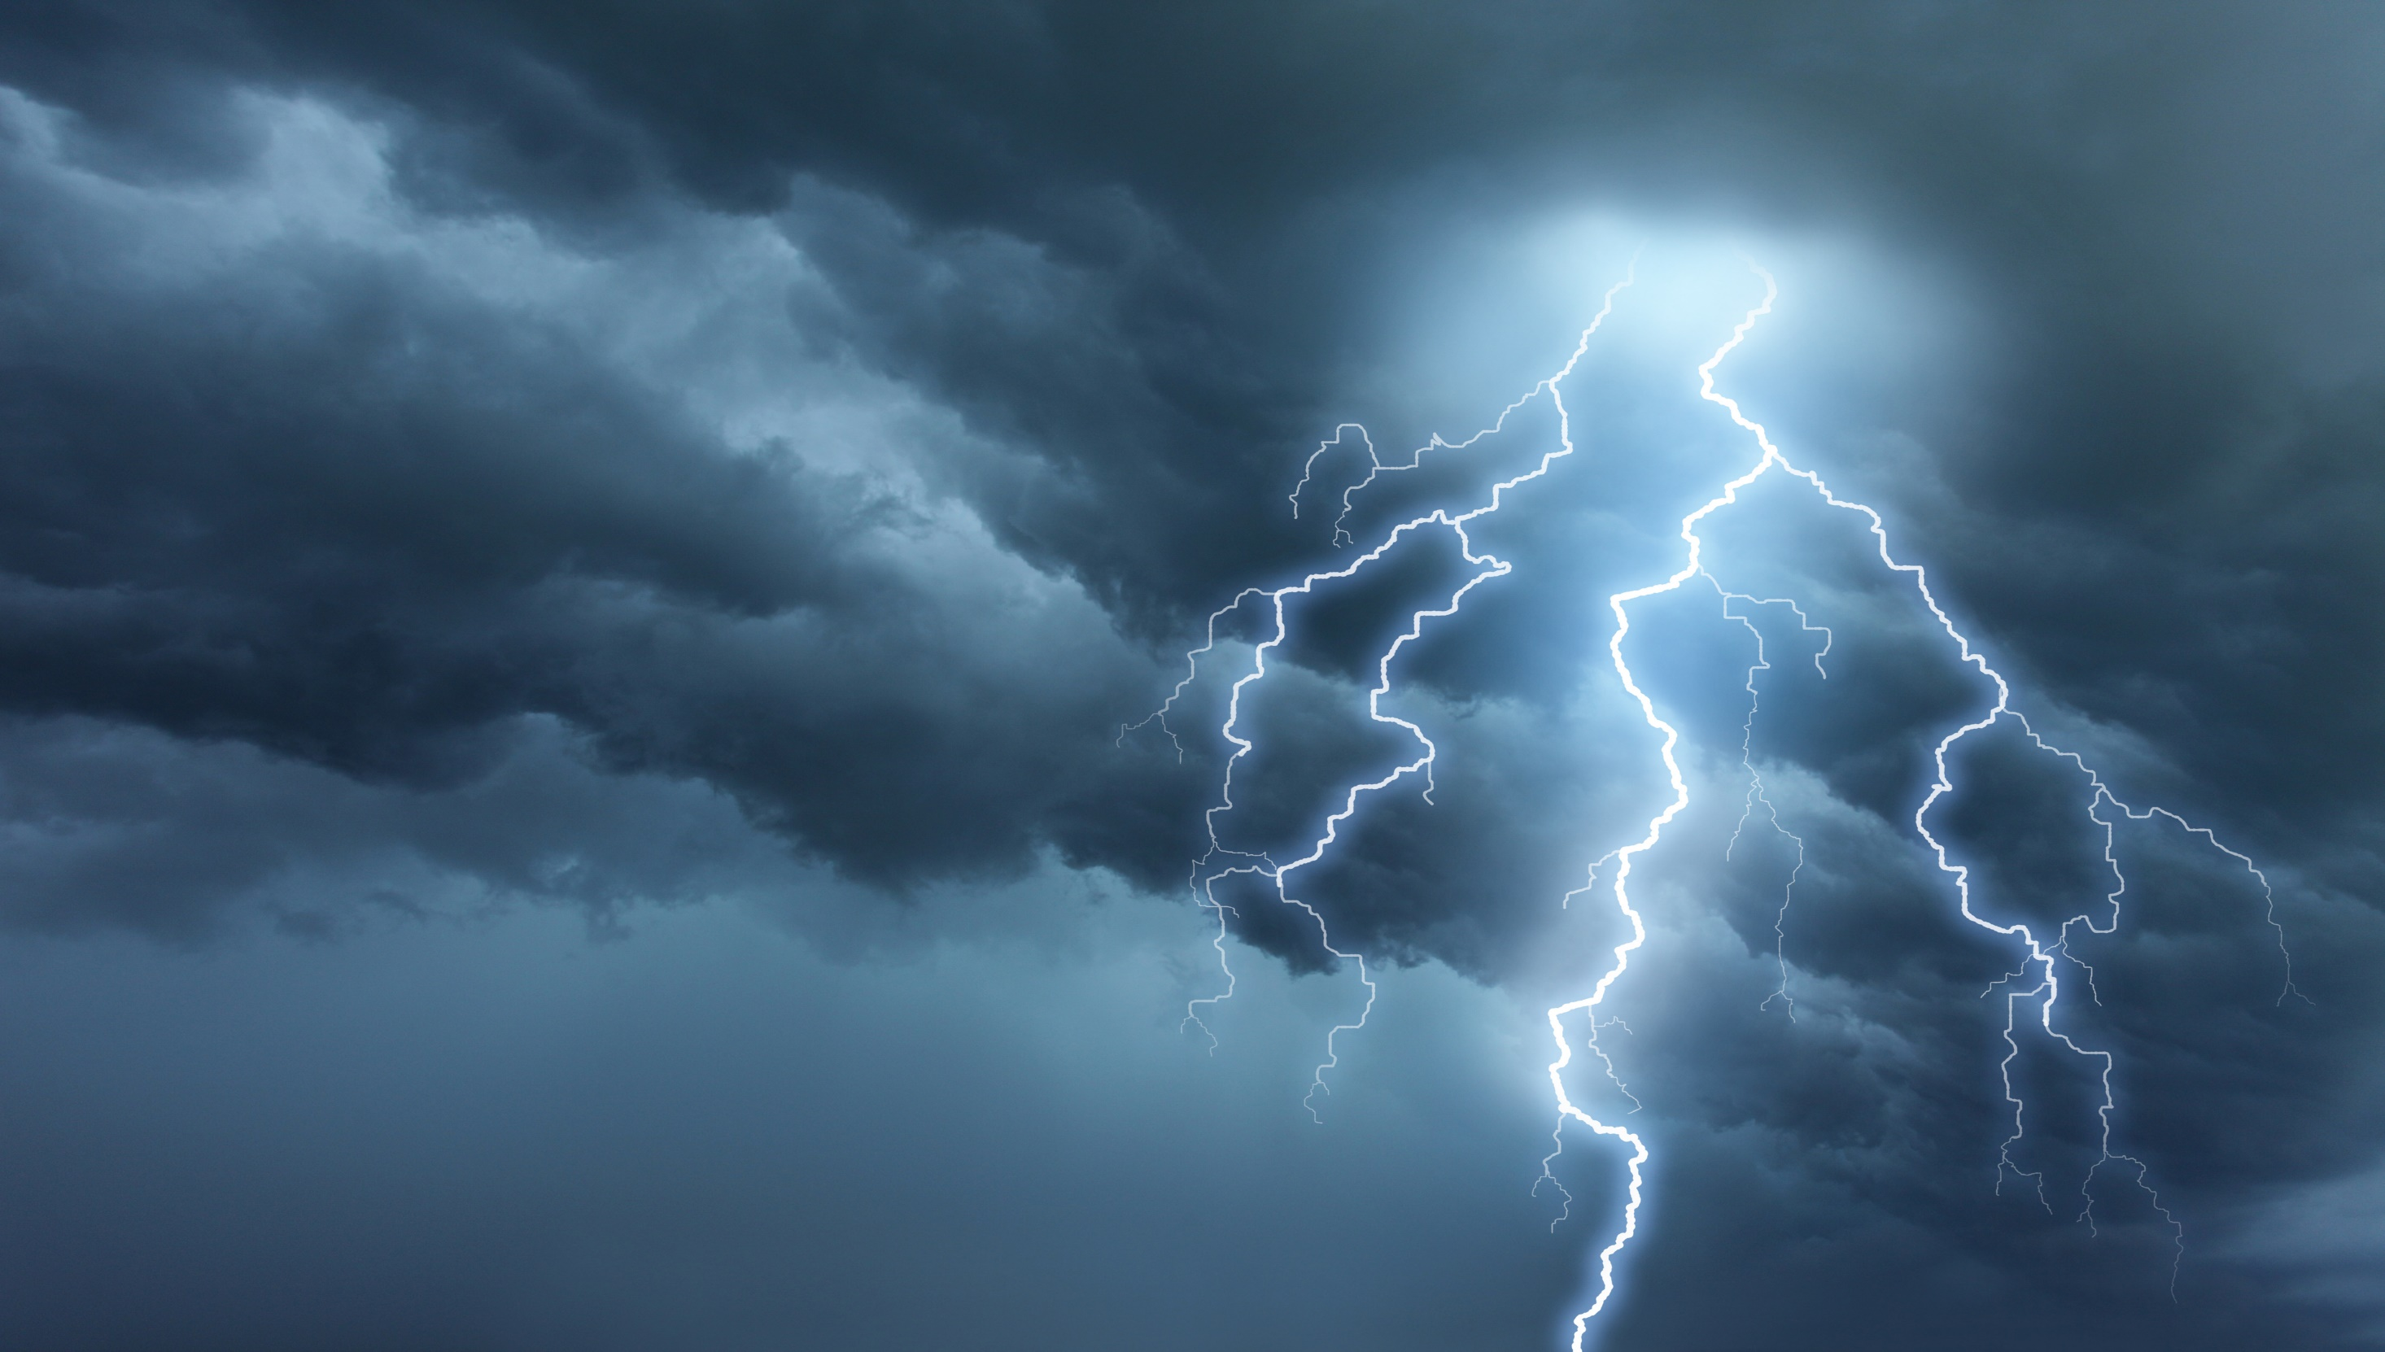
I Can Sleep Through Any Storm

Slide 4
He did his full task and did all of what he should do while he could do it.
Now what does the Bible say on this?

Slide 5
Topics from the Story
Procrastination
Proactiveness
How should we be in the “Storm”?

Slide 6
Procrastination
Procrastinating from indecisiveness
First what is Indecision?
  “a wavering between two or more possible courses of action”
Ecclesiastes 11:4-6 ⁴ He who observes the wind will not sow, And he who regards the clouds will not reap.
Lingering on the “what if’s”
Luke 9:59-62 ⁶² But Jesus said to him, “No one, having put his hand to the plow, and looking back, is fit for the kingdom of God.”

Slide 7
How should we overcome this indecisiveness?
We should take it to the Lord!
1 John 5:14-15 Now this is the confidence that we have in Him, that if we ask anything according to His will, He hears us.
Hebrews 4:14-16 Let us therefore come boldly to the throne of grace, that we may obtain mercy and find grace to help in time of need.

Slide 8
Procrastination from Laziness
Proverbs 6:6-11 11 So shall your poverty come on you like a prowler, And your need like an armed man.
Proverbs 26:13-16 As a door turns on its hinges, So does the lazy man on his bed. The lazy man buries his hand in the bowl; It wearies him to bring it back to his mouth.
How should we overcome this laziness?
James 4:17 ¹⁷ Therefore, to him who knows to do good and does not do it, to him it is sin.

Slide 9
Proactiveness
The Bible tells us we must work while we have the time to work.
Psalms 90:10,12 So teach us to number our days, That we may gain a heart of wisdom.
Proverbs 6:6-8
They work every moment like it’s their last opportunity
The Bible tells us we won’t know how much time we have.
1 Thessalonians 5:2
2 Peter 3:10 But the day of the Lord will come as a thief in the night

Slide 10
Proactiveness
Tomorrow may never come
James 4:13-15 “Today or tomorrow we will go to such and such a city, spend a year there, buy and sell, and make a profit”
Ephesians 5:15-17 ¹⁶ redeeming the time, because the days are evil.
We can’t guarantee that we will have tomorrow to help teach souls who are lost.
Colossians 4:5

Slide 11
How should we be in the “Storm”
Peace and Calmness through Christ
We know that through Christ we can overcome anything.
Philippians 4:13 ¹³ I can do all things through Christ who strengthens me.
But how do we do our part in being calm when the storm is overhead?
Philippians 4:6-7 ⁶ Be anxious for nothing, but in everything by prayer and supplication, with thanksgiving, let your requests be made known to God
Proverbs 3:5
Isaiah 41:10

Slide 12
We Must Prepare for the Storm to calmly sleep through it.
The time is short and tomorrow may never come, how do we be proactive and prepare for this?
We Must:
Hear Romans 10:17
Believe John 8:24
Repent Acts 2:38
Confess Matthew 10:32
Be Baptize Galatians 3:26-27
Being faithful unto death Revelation 2:10f

Slide 13
More importantly, will you be prepared to meet God?
How will you sleep through the storms of life?

